Slide 1
Visualisation hildaplus_GLOB-1-0-f_transitions
File created on: 22-03-2023 17:13:46

Slide 2
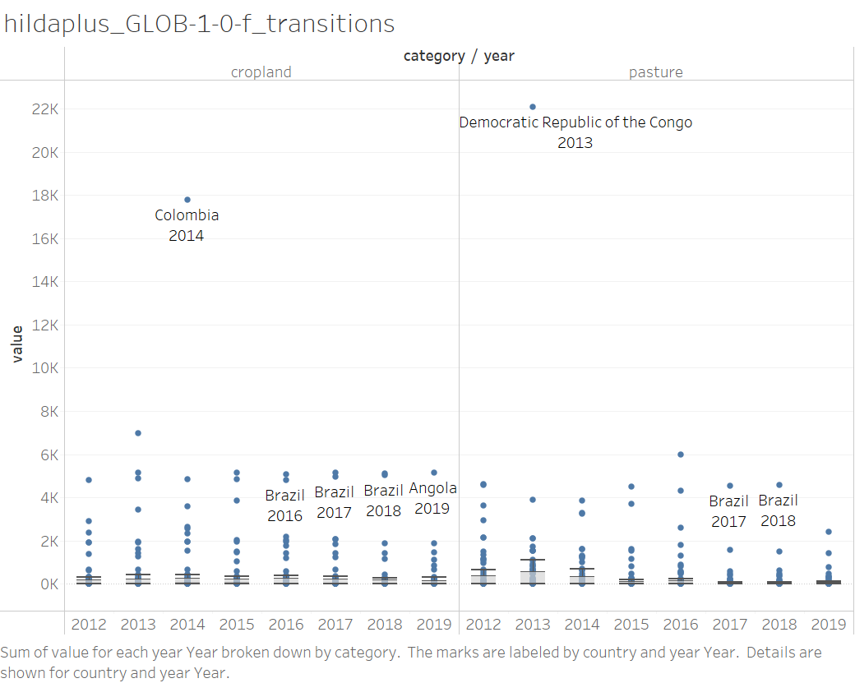

Slide 3
Visualisation hildaplus_GLOB-2-0-f_transitions
File created on: 22-03-2023 17:13:46

Slide 4
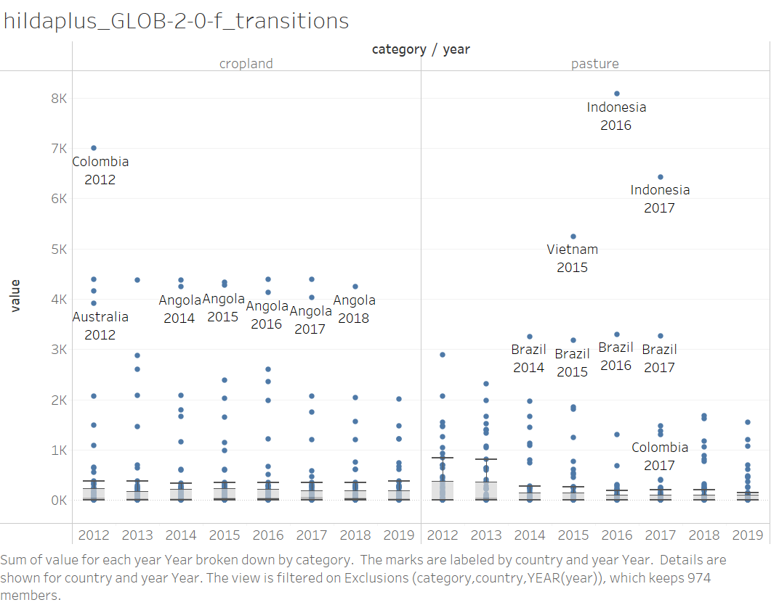

Slide 5
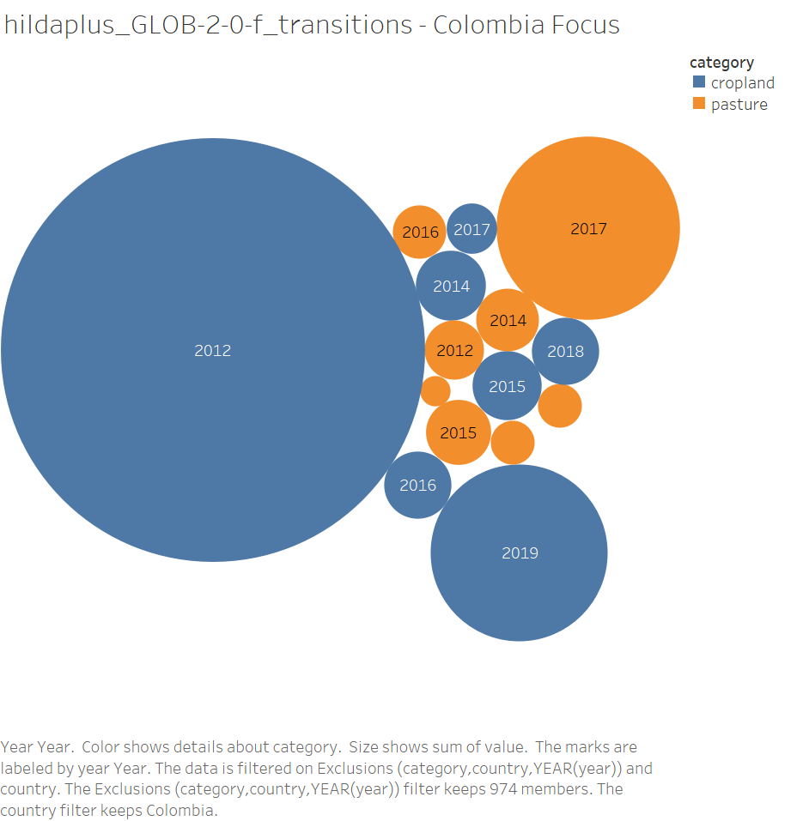

Slide 6
